Slide 1

Data structures using C
Module 4 - Lecture V
Trees
Prepared By
Ms. Smriti Sehgal

Slide 2
AVL Tree
It is a binary search tree in which the difference of heights of left and right subtrees of any node is less than or equal to one.
Adelson (A), Velskii (V), and Landi (L) developed technique of balancing the height of binary trees.
AVL tree is a balanced binary search tree. In an AVL tree, balance factor of every node is either -1, 0 or +1.
Balance factor = (height of left subtree) – (height of right subtree)

Slide 3
It can be defined as:
Let ‘T’ be a non-empty binary tree with T_{L} (left subtrees) and T_{R} (right
subtrees).
The tree is height balanced if:
T_{L} and T_{R} are height balanced
H_{L} - H_{R} <= 1, where H_{L} - H_{R} are the heights of T_{L} and T_{R}
The Balance factor of a node in a binary tree can have value 1, -1, 0.
These values depend on whether the height of its T_{L} is greater, less than or equal to the height of T_{R}.

Slide 4
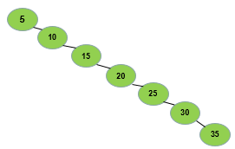
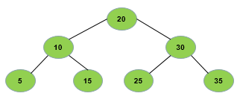
What are the advantages of AVL tress?
Low time complexity
Example:
Let a tree having keys 5, 10, 15, 20, 25, 30, 35, then the trees will be like:
Tree 1
Tree 2

Slide 5
Now, to insert a node in the binary tree, the algorithm requires seven comparisons (in case of tree-2),
But insertion of the same key in AVL tree, algorithm will require three comparisons.

Slide 6
Eg.

Slide 7
Eg.

Slide 8
Rotations
Single Left Rotation (LL Rotation)
In LL Rotation every node moves one position to left from the current position. (Note: we see path in which node is inserted/deleted)

Slide 10
Single Right Rotation (RR Rotation)
In RR Rotation every node moves one position to right from the current position.

Slide 12
Left Right Rotation (LR Rotation)
LR rotations is to be performed if the new node is inserted into the right of left sub-tree of the critical node A.
First single L rotation (RR) and then single R rotation(LL) is performed.

Slide 14
Right Left Rotation (RL Rotation)
RL rotations is to be performed if the new node is inserted into the left of right sub-tree of the critical node A.
First single R rotation (LL) and then single L rotation(RR) is performed.

Slide 16
Operations on AVL tree
Algorithm (for insertion):
Step 1: insert a new element into the tree using Binary Search Tree insertion logic.
Step 2: After inserting the elements, check the Balance Factor of each node.
Step 3: When the Balance Factor of every node will be like 0 or 1 or -1, algorithm will proceed for the next operation.
Step 4: When the balance factor of any node comes other than the above three values, tree is said to be imbalanced.
Then perform the suitable Rotation to make it balanced and then the algorithm will proceed for the next operation.

Slide 22


